Slide 1
Midterm Progress Report
On Financial Pricing Engine with Vital Mendonca Filho and Nicholas Wotton
By Pavee Phongsopa

Slide 2
A-Term
Summary
Linear Approximation with base setup
Non-Linear Approximation with ReLU
Non-Linear Approximation with Sigmoid
Neural Network Setup optimizer

Slide 3
Neural Network/Deep Learning
GitHub Reference: https://github.com/songqsh/MQP2019/blob/master/Nick/Copy_of_linearfunction01.ipynb

Slide 4
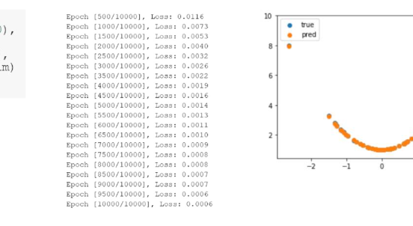
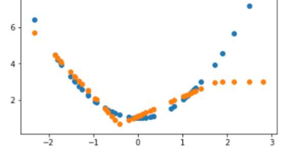
Approximation with ReLU
Number of neurons and layers affect the prediction accuracy
Not one size fit all
Very accurate if given enough resources

Slide 5
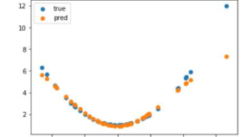
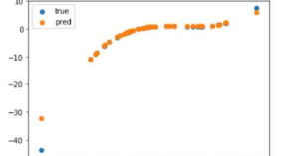
Approximation with Sigmoid
Graphs tend to diverge at both ends of the prediction
Slightly Faster
Less accurate compare to ReLU

Slide 6
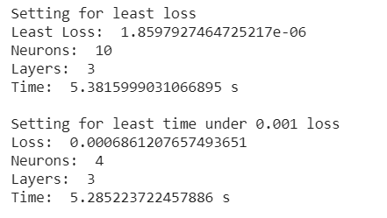
Neural Network Setup Optimizer
Takes in Maximum Layers and Neurons
Start Testing from 2 layers and 2 neurons

Slide 7
B-Term
Summary
CRR Model
CRR Model with Neural Network

Slide 8
CRR Model
Wikipedia Reference: https://en.wikipedia.org/wiki/Binomial_options_pricing_model

Slide 9
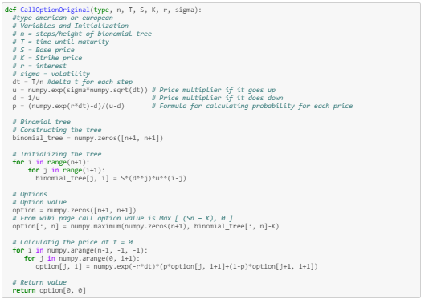
European Option
From the wiki page example I translate the code into python code which return an option value after it is done back tracking.

Slide 10
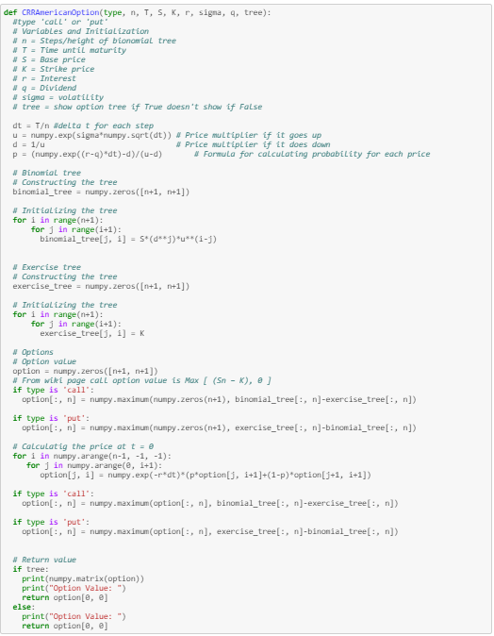
American Option
The code gives out the same output as the previous European option when the dividend is set to 0.

Slide 11
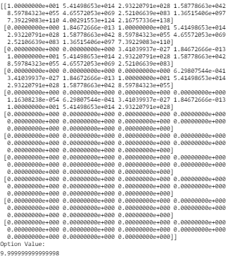
American Option
The code gives out the same output as the previous European option when the dividend is set to 0.

Slide 12
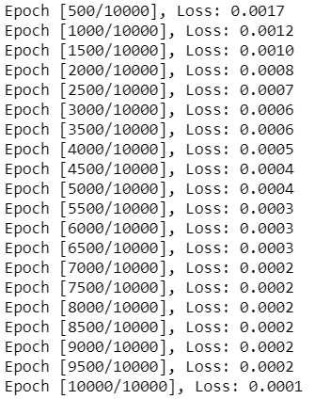
CRR Model with Neural Network
100 Randomized data per epoch which was fed into CRR American option Model
Looks promising

Slide 13
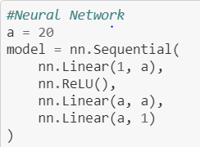
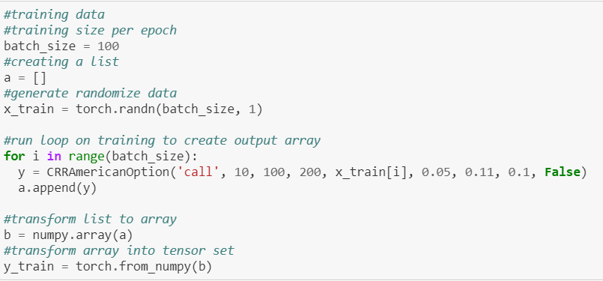
CRR Model with Neural Network

Slide 14
C-Term Anticipation
Summary
Q-Learning
Online Broker API

Slide 15
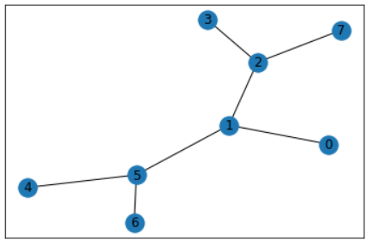
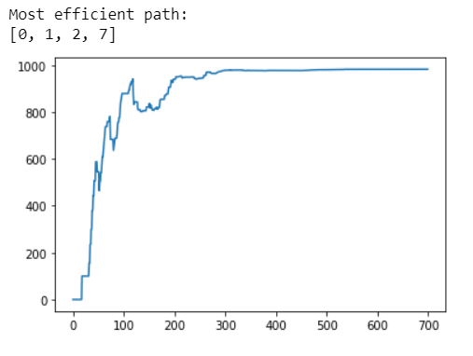
Q-learning
Task: Find the fastest Route to the vertex with displayed value 7.
GitHub Reference: https://github.com/songqsh/MQP2019/blob/master/Pavee/qlearning_sample.ipynb

Slide 16
References
GitHub Reference: https://github.com/songqsh/MQP2019/blob/master/Pavee/test%20run.pdf
GitHub Reference: https://github.com/songqsh/MQP2019/blob/master/Pavee/Test%20Run%20%232.pdf
GitHub Reference: https://github.com/songqsh/MQP2019/blob/master/Pavee/Optimizer.ipynb
Wikipedia Reference: https://en.wikipedia.org/wiki/Binomial_options_pricing_model
GitHub Reference: https://github.com/songqsh/MQP2019/blob/master/Pavee/CRR_Model.ipynb
GitHub Reference: https://github.com/songqsh/MQP2019/blob/master/Pavee/Deep_learning_for_CRR.ipynb
GitHub Reference: https://github.com/songqsh/MQP2019/blob/master/Pavee/Complete_CRR_Neural_Network.ipynb
GitHub Reference: https://github.com/songqsh/MQP2019/blob/master/Pavee/symposium.pdf
GitHub Reference: https://github.com/songqsh/MQP2019/blob/master/Pavee/qlearning_sample.ipynb
GitHub Reference: https://github.com/songqsh/MQP2019/blob/master/Pavee/InteractiveBroker_API.ipynb

